Slide 1

SAP BTP ABAP on Cloud / RAP Training
DAY-30
Anubhav Oberoy
www.AnubhavTrainings.com
Follow excellence with sheer passion

Slide 2


DISCLAIMER
The training content and delivery of this presentation is confidential, and cannot be recorded, or copied and distributed to any third party, without the written consent of Anubhav Trainings

Slide 3

01
Attachments
02
Attachments
03
Custom Entity
04
Extensibility
Notes:
https://pixabay.com/photos/san-francisco-transamerica-pyramid-1633203/

Slide 4
Attachments
Starring SAP ABAP on Cloud release 2208 SAP started direct support for attachments (PDF, Excel, Images, TXT, Word) including binary files. We must need to create a database table with atleast following columns
Attachment (Data type: RAWSTRING length 0)
Mimetype (Document type, String128)
Filename (Document Name, String128)
Travel
Attachments
1 n
www.anubhavtrainings.com

Slide 5
Steps
Create new attachment table according to need and design
Create a Interface Entity for the attachment table and mark our attachment field with special attachment annotation, So the RAP framework can treat it as an attachment accordingly.
Add annotations for admin fields, and user labels.
Create composition of our attachment table with travel entity like we had the composition of booking with travel entity.
Create a projection view for attachment
Relationship between Travel processor view with attachment processor view entity
Enhance the BDEF with attachment like booking
Also expose the attachment functionality with draft to processor in behavior projection for processor
Expose the entity of attachment processor in service definition
Republish the OData V4 binding
Add the metadata extension for attachment scenario and link a new facet in travel for attachment table
Testing
www.anubhavtrainings.com

Slide 6












Slide 7
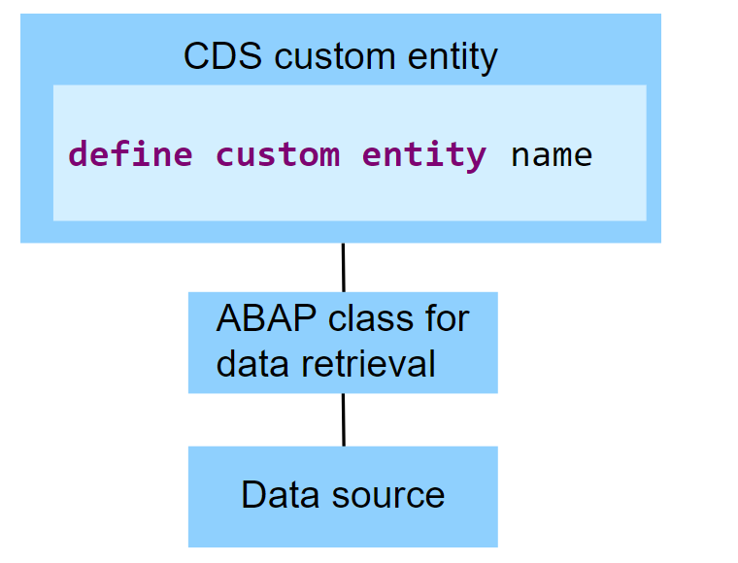
Custom Entities
A CDS custom entity allows developers to implement their own data retrieval using ABAP. A CDS custom entity is linked with an ABAP class and the data retrieval is executed on the application server. At the CDS level, only an interface is defined. Custom entities are used when data can't be accessed using SQL and the available CDS feature set.
The following image exemplifies the runtime of a CDS custom entity. It shows that the data retrieval is implemented by an ABAP class and the data source does not have to be a database table.
www.anubhavtrainings.com

Slide 8
Reference Scenario – Custom Entity
In this exercise, we want to replace the travel agencies data of our managed travel app with the results of the remote OData service that provides different set of travel agencies from other system altogether. For this use case, we shall leverage the concept of a custom entity. In contrast to "normal" CDS views that read data from the database tables or other CDS views, the so-called custom entities act as a wrapper for a code-based implementation that provides the data instead. This use case involves following steps.
Creating the Service Consumption Model
Defining the Custom CDS Entity
Create a class that implements the query for the custom entity
Integrate the custom entity in MDE
www.anubhavtrainings.com

Slide 9
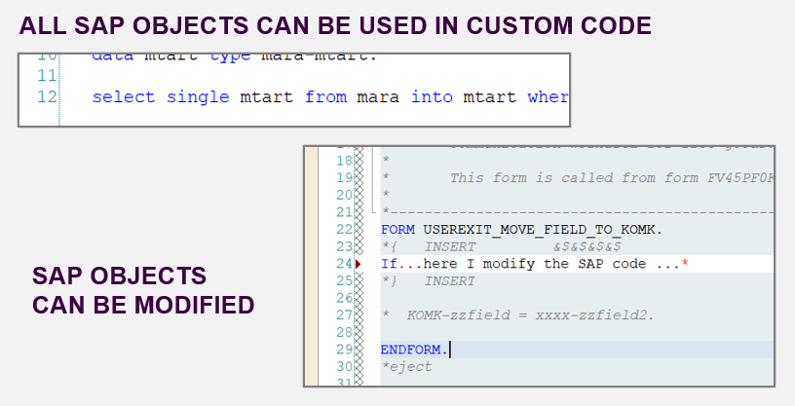
From classic ABAP extensions to ABAP Cloud development
<>
www.anubhavtrainings.com

Slide 10
What is ABAP Cloud Development Means:
Use public SAP APIs (local or remote) released by SAP to access SAP functionality and SAP data
Use public SAP extension points released by SAP to extend SAP objects. Modifications to SAP standard objects are not supported (applies to S/4HANA Cloud system)
Use of Adt (ABAP development tools) on eclipse
Use Steampunk (RAP – Restful Application Programming model) to build Fiori Applications and services. SAP technologies like Dynpro and webdynpro are not released for cloud development.
www.anubhavtrainings.com

Slide 11
What is Embedded Steampunk
If we are using SAP BTP to develop side by side extensions, full stack SAP applications in BTP (Steampunk)
If we are using In-app Developer extensibility with released objects in S/4HANA (all editions) with RAP (Embedded Steampunk)
If you using RAP and enhancing your Standard SAP Applications delivered by SAP in S/4HANA system, the recommended approach is Embedded Steampunk.
Every Customer using S/4HANA can decide whether they want to use new approach (embedded Steampunk) or classic extension approach (BADI) @ Object level
This can be done by switching a setting @ object level.
www.anubhavtrainings.com

Slide 12
www.anubhavtrainings.com
Thank You
End of Day 30
www.anubhavtrainings.com

Slide 13


We’re committed to empower you to be
FutureReady
through powerful training solutions.
We build the workforce of the future.
250+
Corporate Clients
30,000+
Learners Trained
25000+
Learners Placed
FREE WEBINARS
Sign up for free webinars with industry experts every fortnight!
Enroll Now!
Contact us today!
https://anubhavtrainings.com

